Slide 1
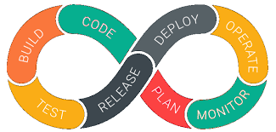
Introducing DevOps

Slide 2
Contents:
What is DevOps?
Why DevOps?
DevOps Implementation.
DevOps Life cycle.
How DevOps Improved the Development and Operation Process?

Slide 3
What is DevOps?
DevOps word in itself is a combination of two words one is Development and other is Operations. It is neither an application nor a tool; instead, it is just a culture to promote development and Operation process collaboratively. As a result of DevOps implementation, the speed to deliver applications and services has increased.
DevOps enables organizations to serve their customers strongly and better in the market.
In other words, we can say that DevOps is the process of alignment of IT and development operations with better and improved communication.

Slide 4
Why DevOps?
DevOps implementation has increased the rate of software delivery and the revenue for business stakeholders. Following listed reasons are the most considerable ones that led to the creation of DevOps.
Before DevOps, operation and development teams were working in an isolated environment.
Testing and Deployment activities mostly were performed in an isolated manner after design-build step, and they took more time than actual project completion time.
Team members usually spend a large amount of time in deploying, testing, designing, and building the projects
Human production errors were deployed during manual code conduction.
Operations and coding teams generally had different timelines and did not have proper synchronization that results in further delay.

Slide 5
Why DevOps?
To avoid the hassles mentioned above and non-collaborative performance measures, there was an urgent need for robust IT technology like DevOps to satisfy business owners and stakeholders.

Slide 6
DevOps Implementation
“DevOps is not a goal but a never-ending process of continual improvement.”

Slide 7
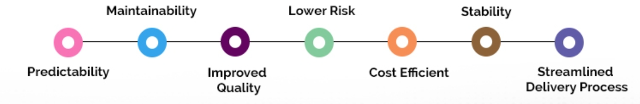
DevOps Implementation
The DevOps offer continuous integration and continuous delivery. It makes the product delivery cycle quicker, and enterprises become able to launch the software timely without compromising its quality.
Notes:
Predictability: DevOps decreases the failure rate of new product releases.
Maintainability: The process improves the overall recovery rate at the time of the release event.
Improved Quality: DevOps improves the quality of product development by incorporating infrastructure issues.
Lower Risk: Security aspects are incorporated in SDLC, and the number of defects gets decreased across the product
Cost Efficient: Cost efficiency is improved due to DevOps that is always an aspiration of every business organization.
Stability: DevOps implementation offers a stable and secure operational state.
Streamlined Delivery Process: As DevOps provides streamlined software delivery, marketing effort is reduced up to 50%. It happens due to the mobile application and digital platform.

Slide 8
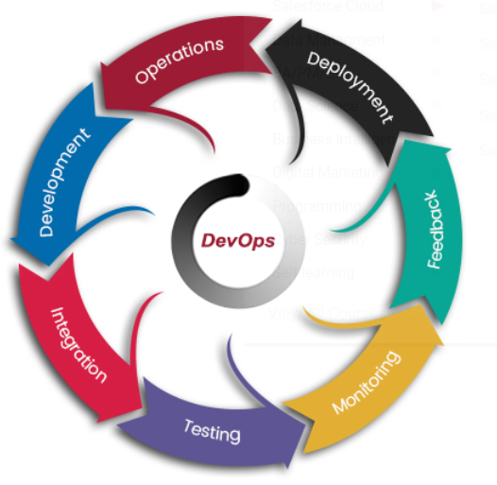
DevOps Life cycle
Understanding DevOps is not complete without understanding the DevOps lifecycle phases. The continuous DevOps lifecycle includes seven phases as given below.
Continuous Development
Continuous Integration
Continuous Testing
Continuous Monitoring
Continuous Feedback
Continuous Deployment
Continuous Operations
Notes:
1). Continuous Development
(Plan application objectives and Code the requirements)
In the first phase of DevOps lifecycle, you should plan your application objectives that must be delivered to the customer.
Once you are sure of application objectives, start with the project development. It includes activities like code generation and putting the same to the next phase. As DevOps follows the continuous development approach, work may carry out on the existing code by using continuous feedback in the development and operation scheme.
2). Continuous Integration
(Plan Tests and Build the product)
The continuous integration process automatically starts after development. It includes several steps like the planning of tests that will be carried out in the next phase, understanding the code to produce the desired outcome as needed in the initial project documentation. Continuous integration is the seamless process in DevOps that leads to the next phase in an efficient manner.
3). Continuous Testing
(Verify the product for actual usage in a live environment)
Testing process checks the actual use of an application in the DevOps. Beta testers produce results while still ensuring that application can have its intended use in a live environment. The testing process gives more information about different aspects of an application that in turn is sent to the development process to improve the application.
4). Continuous Monitoring
(Monitor the product output and find the problem areas)
The monitoring phase is the operational phase in DevOps where key information about application usage is recorded and carefully processed to find out trends and identify the problem areas. It enhances the operational efficiencies of a software product that may occur in the form of documents or produce massive data about application parameters when the application is in a continuous use position.
5). Continuous Feedback
(Improvise the current product and helps to release new versions quickly)
Read: Ultimate and Easy Ways About Jenkins Code Analysis To make you SuccessfulThe application performance is improved consistently by analyzing the final outcome of the product. The continuous feedback is an important phase of the software application where customer feedback is a big asset to improve the working of the current software product and release new versions quickly based on the response.
6). Continuous Deployment
(Ensures product is deployed with maximum accuracy)
The deployment process is performed in such a way that any changes made in the code should not affect the functioning of high traffic website.
7). Continuous operations
(Automate release process with shorter development cycles)
All DevOps operations are based on continuity with complete automation of the release process and allow organizations to accelerate the overall time to market on an ongoing basis.

Slide 9
How DevOps Improved the Development and Operation Process?
DevOps solves development challenges in the following ways:
Code deployment time is reduced because of the faster testing process and speedy feedback mechanism.
Developers do not feel work pressure and can build new code in less time.

Slide 10
How DevOps Improved the Development and Operation Process?
As far as operation process execution is concerned, then implementation of DevOps improves the operational processes in the following ways:
Configuration management helps the organization to execute and organize the configuration plans, and they become able to manage their infrastructure in an effective
Containers and virtualization concepts provide a simulated environment to increase software reliability and maintain uptime of the production environment.
Effective and improved server monitoring is offered. As a result of this, proper feedback can be provided, and effective administration is assured.

Slide 11
References
https://www.janbasktraining.com/blog/devops-tutorial/
https://www.janbasktraining.com/blog/devops-tutorial/#WhatisDevOps
https://www.janbasktraining.com/blog/what-is-devops-lifecycle/

Slide 12
Thanks!

